Slide 1

ST. JOSEPH’S FIRST GRADE COLLEGE
JAYALAKSHMIPURAM, MYSURU-570012
A PROJECT REPORT ON
“Digital Table Menu”
Presented by
Varsha BC Reg No: BC170879
Ashik ED Reg No:BC170809
Under the Guidance of
Mr. Rachappa Naik
Assistant Professor

Slide 2
DIGITAL TABLE MENU

Slide 3
Introduction
This system is used throughout the restaurant and retail industry.
Digital table menu is an innovative and interactive web based menu.
This Digital menu can definitely improve the services of Restaurant and Hotel Industries.
It will increase the speed of table turnovers and also , increase customer’s satisfaction.
Restaurant business’s revenue will also be enhanced

Slide 4
Existing System:
Paper menu
Normal Customer Service
Book Management System
Hiring and Training Staff
Multi Task for the waiters

Slide 5
Proposed System:
Digitalized Table Menu
Restaurant owner has all the access
Customer Friendly Automation
Added Inventory Staff
Feedback System
Stock Management

Slide 6
Advantages:
Easily change or update the important information on the menu
Adding new items on the menu and changing the price of items is now easy
Reduce perceived way times and enhances customers dining experience
Eliminates the traditional systems of taking orders and submitting bills
It can display emergency messages quickly
It eliminates recurring cost associated with printing of paper menus.

Slide 7
Modules
Admin Module
Chef Module
User Module
Farmer Module
Retailer Module

Slide 8
Admin Module
Owner
Web based browsing setup
Modification of items and price
Product list
The inventory management
Details of the customer
Daily sales report , yearly report

Slide 9
Chef Module
Prepare food
Order product
Inventory management
Profile update
Password update

Slide 10
User Module
Browse food
Cart
Profile update
Password update

Slide 11
Farmer Module
Manage product
Profile update
Password update

Slide 12
Retailer Module
Manage product
Profile update
Password update

Slide 13
System requirement specification
Hardware Requirements:
Processor : Pentium IV onwards
RAM : 2GB +
Hard disk space : 40GB +
Standard PC configuration to carryout challenging computing
Software Requirements:
Operating System : Windows XP or Higher
IDE : Visual Studio 2010
Language : C#
Framework : ASP.NET 4.0
Back End : MS SQL Server

Slide 14
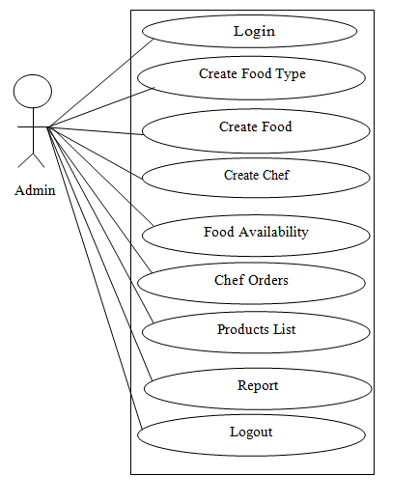
Use Case Diagram
Admin Module:

Slide 15
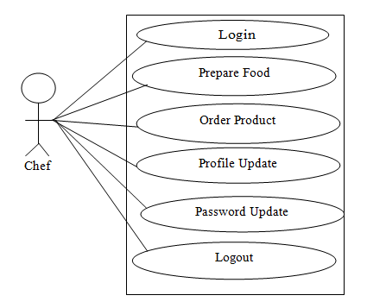
Chef Module:

Slide 16
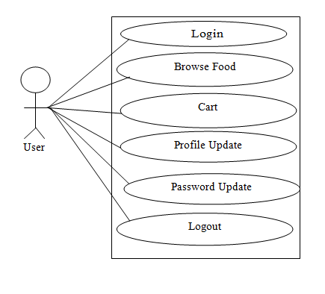
User Module:

Slide 17
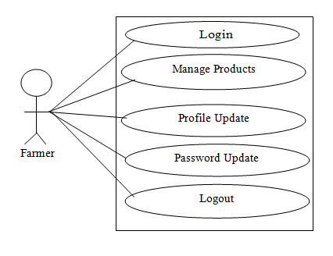
Farmer Module:

Slide 18
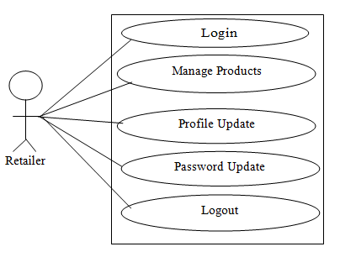
Retailer Module:

Slide 19
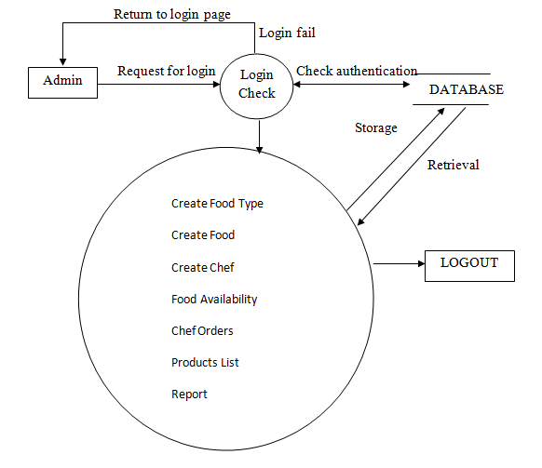
Data Flow Diagram
Admin Module:

Slide 20
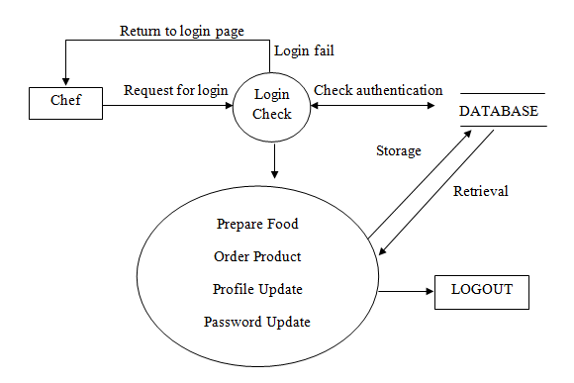
Chef Module:

Slide 21
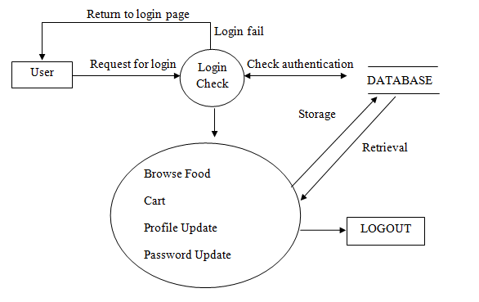
User Module:

Slide 22
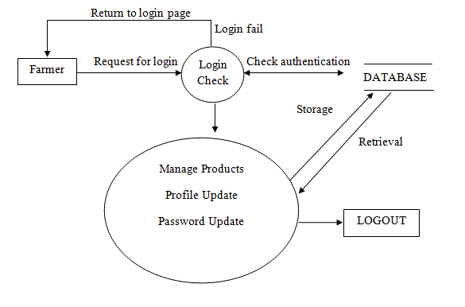
Farmer Module:

Slide 23
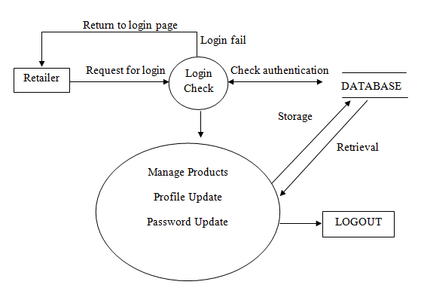
Retailer Module:

Slide 24
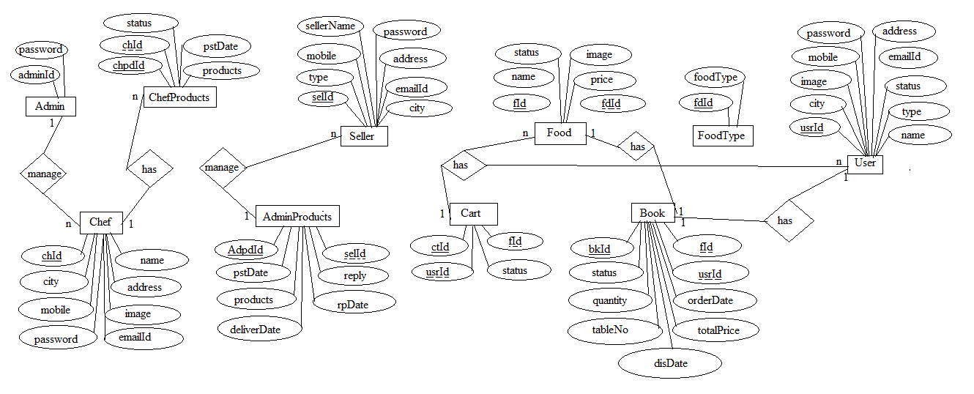
ER Diagram :

Slide 25
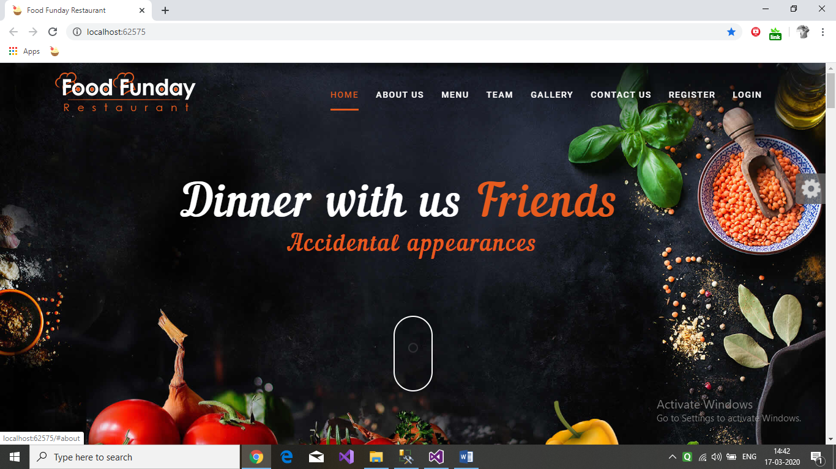
Snapshots

Slide 26
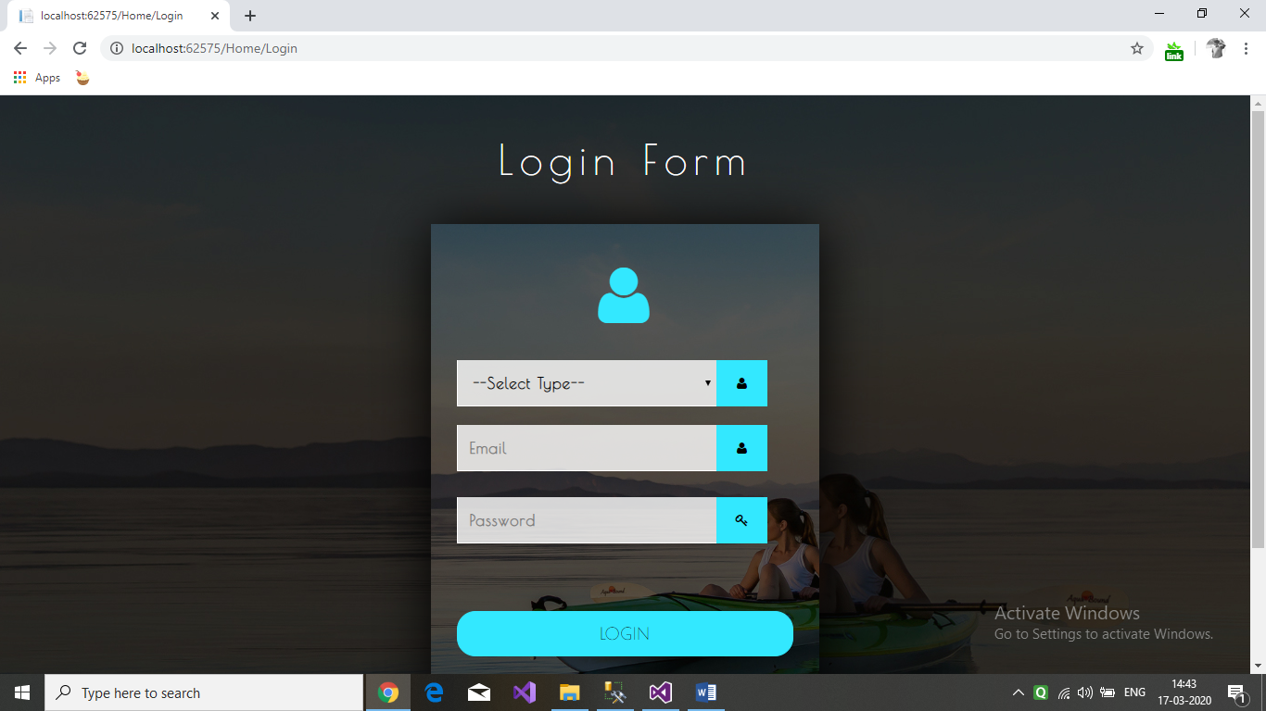

Slide 27
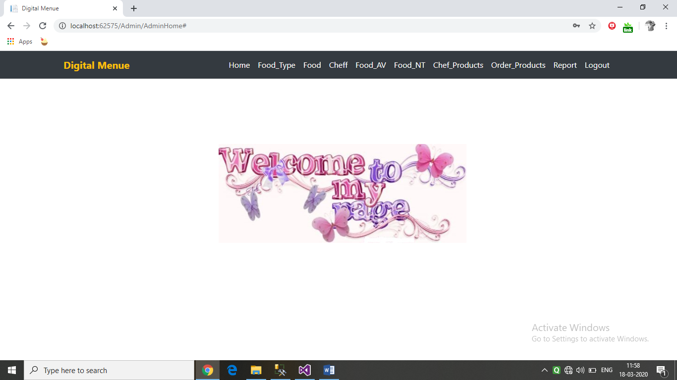

Slide 28
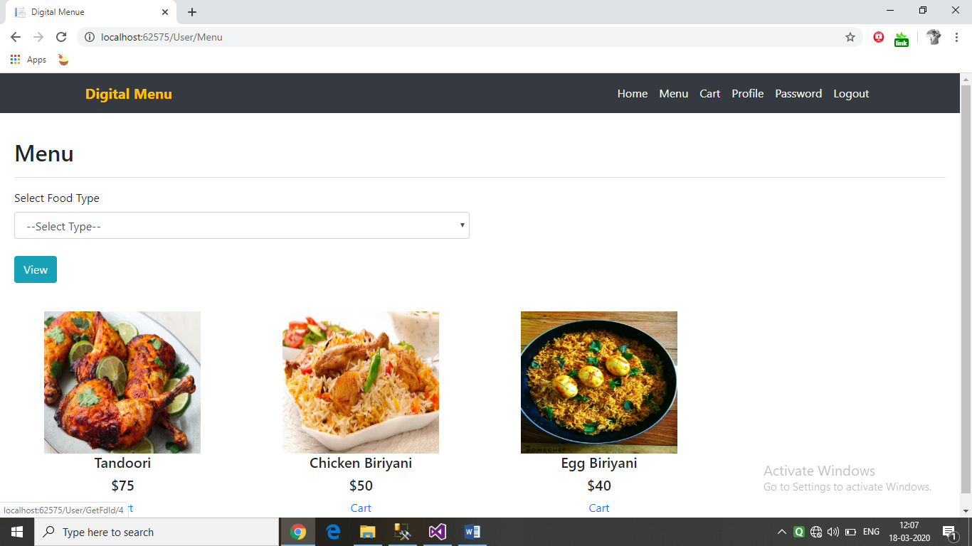

Slide 29
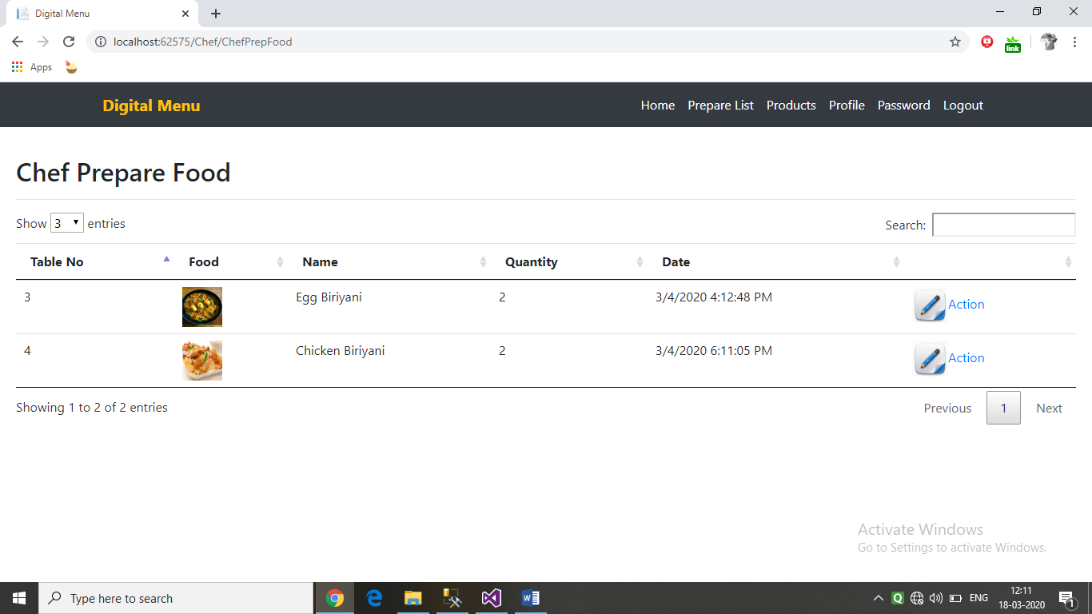

Slide 30
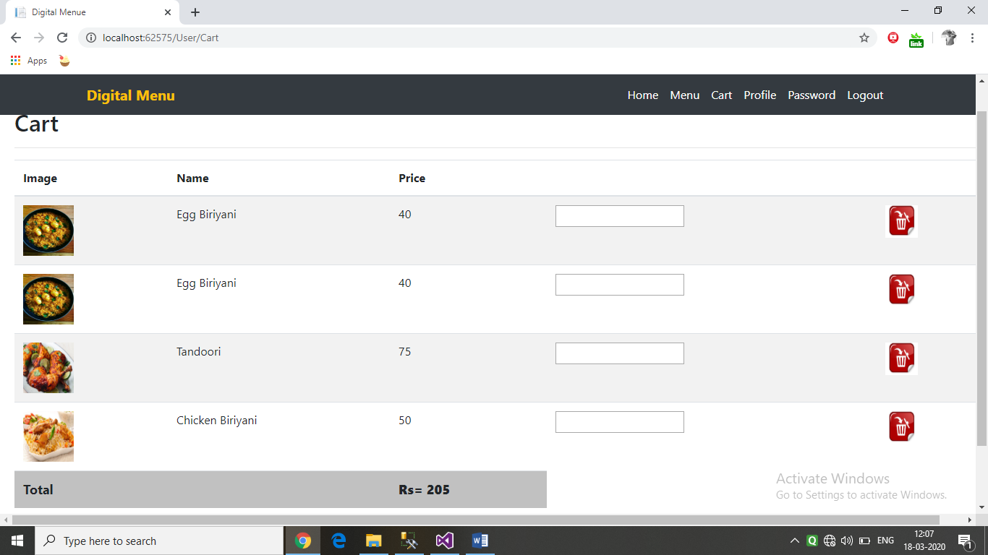

Slide 31
Conclusion
The proposed system of digital menu which is an online application is beneficial for the users that will help them to order food in the restaurants. Our application will also help the chef of the restaurant to order the required ingredients required for preparation of food by placing order to the farmers or retailers.

Slide 32
Future Enhancement
In future, the application can be enhanced by taking this web based project to mobile application .So that the user can interface with more compatibility.
This application can be implemented on AR which enables the user to change the apparent colour, texture, and even the size of the food they are eating
Simple multisensory dining experience by the display of type of videos which is accordingly to the dish you are eating

Slide 33
THANK YOU

